Slide 1


ບົດ​ຮຽນ​ທີ່​ຖອດ​ຖອນ​ໄດ້
ໃນ​ການ​ສືບ​ສວນ-ສອ​ບ​ສວນ ແລະ ການ​ດຳ​ເນີນ​ຄະ​ດີ
ການ​ຄ້າ​ມະ​ນຸດແບບ​ຂ້າມ​ຊາດ
.
Notes:
Ladies and gentlemen, Good Afternoon. Thank you for the given opportunity to be able to share with you and highlight some of the accomplishments achieved by both the Philippine National Police and the Royal Malaysia Police as a result of our Bilateral Cooperation.

Slide 2





ກອງປະຊຸມແບບສອງຝ່າຍລະ​ຫວ່າງສຳນັກງານຕຳຫຼວດແຫ່ງຊາດປະເທດຟີລິບປິນ (PNP) ແລະ ສຳນັກງານຕຳຫຼວດແຫ່ງຊາດປະເທດມາເລເຊຍ (RMP)
ລຳ​ດັບ | ວັນ​ທີ | ​ສະ​ຖານ​ທີ່
1 | ​ກັນ​ຍາ 2015 | ​ມາ​ລັກ​ກາ, ​ປະ​ເທດມາ​ເລ​ເຊຍ
2 | ພະ​ຈິກ 2015 | ມາ​ຄາ​ຕິ, ປະ​ເທດ​ຟີ​ລິບ​ປິນ
3 | ກັນ​ຍາ 2016 | ​ກົວ​ລາ​ລຳ​ເປີ, ປະ​ເທດ​ມາ​ເລ​ເຊຍ
4 | ກຸມ​ພາ 27 | ມາ​ຄາ​ຕິ, ປະ​ເທດ​ຟີ​ລິບ​ປິນ
5 | ພຶດ​ສະ​ພາ 20017 | ​ກົວ​ລາ​ລຳ​ເປີ, ມາ​ຄາ​ຕິ
6 | ຕຸ​ລາ 2017 | ມາ​ຄາ​ຕິ, ປະ​ເທດ​ຟີ​ລິບ​ປິນ
7 | ພຶດ​ສະ​ພາ 2018 | ​ກົວ​ລາ​ລຳ​ເປີ, ປະ​ເທດ​ມາ​ເລ​ເຊຍ
8 | ກໍ​ລະ​ກົດ 2019 | ເມືອງ ເທ​ເຕ​ເຕ, ປະ​ເທດ​ຟີ​ລິບ​ປິນ
9 | ພະ​ຈິກ 2019 | ໂຄ​ຕາ ຄິ​ນາບາລູ, ປະ​ເທດ​ມາ​ເລ​ເຊຍ
10 | ກໍ​ລະ​ກົດ 2020 | ​ກອງ​ປະ​ຊຸມ​ອອນ​ລາຍ​ທາງ​ໄກ
Notes:
Due to its proximity and accessibility, Malaysia has been a destination country for Filipinos seeking employment overseas, hence, is not spared on the prevalence of undocumented Filipinos as well as trafficking victims.
With the initiative of the ASEAN-Australia Counter-Trafficking, formerly the Australia-Asia Program to Combat Trafficking in Persons (AAPTIP) the bilateral meetings with Royal Malaysian Police (RMP) and its government was initiated.
A total of nine face to face bilateral meetings were already concluded and one virtual meeting due to the pandemic . Amongst the notable outcomes of those meetings is the establishment of point of contact in each country; information and referral mechanism for shared investigation of cases which resulted to the rescue of Filipino women victims of TIP and arrest of suspects in Malaysia. These successful operations were conducted jointly by the PNP and the RMP.

Slide 3
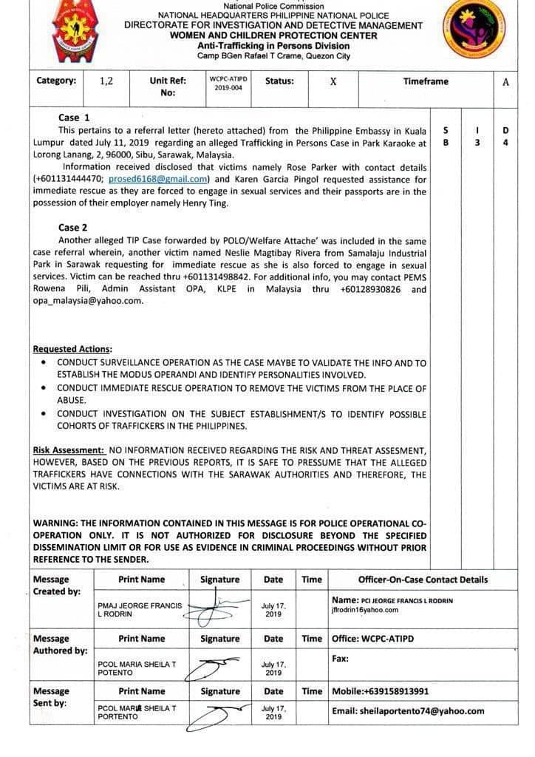
ຜົນ​ໄດ້​ຮັບ (Gains)
ຮູບ​ແບບ​ການ​ແບ່ງ​ປັນ​ຂໍ້​ມູນ
Notes:
To expedite processing of case referrals, both the PNP and RMP came up with a template on information sharing which provides a comprehensive report on the case being referred and indicates the level of priority.-

Slide 4
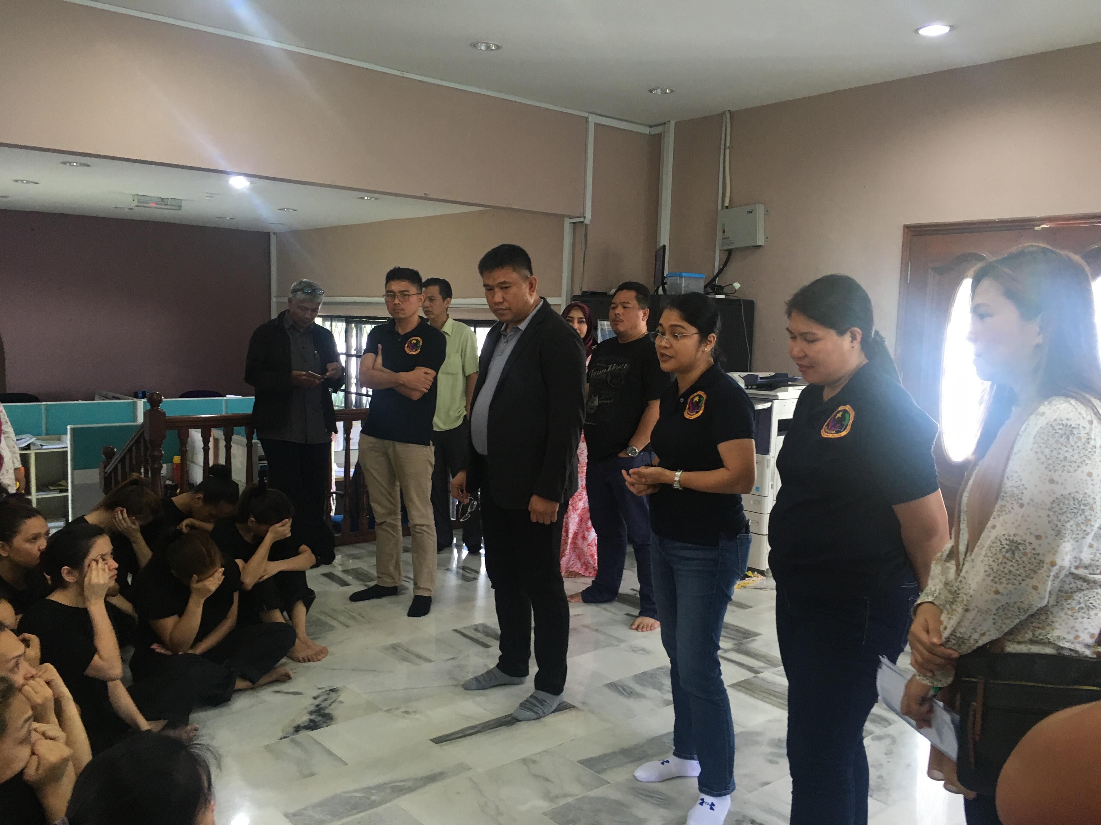
ຜົນ​ໄດ້​ຮັບ (Gains)
2. ການ​ປະ​ຕິ​ບັດ​ງານ ເພື່ອກອບ​ກູ້
- ຄົນ​ຟີ​ລິ​ປິນ 27 ຄົນ ໄດ້​ຮັບ​ການກອບ​ກູ້​ໂດຍ RMP ໃນ​ວັນ​ທີ 15 ສິງ​ຫາ 2018
- ທີມ WCPC ໄດ້​ຮັບ​ການ​ຊ່ວຍ​ເຫຼືອ​​ຈາກ RMP ໃນ​ການ​ສຳ​ພາດ​ຜູ້​ຖືກ​ເຄາະ​ຮ້າຍ
ຜູ້​ຖືກ​ເຄາະ​ຮ້າຍ​ໄດ້​ຖືກ​ປົກ​ປ້ອງ​ພາຍ​ໃຕ້​ລະ​ບຽບ​ການ​ປົກ​ປ້ອງ​ຊົ່ວ​ຄາວ ແລະ ໄດ້​ຖືກ​ກຳ​ນົດ​ຕົວ​ວ່າ​ເປັນ​ຜູ້​ຖືກ​ເຄາະ​ຮ້າຍ
- ຄະ​ດີ​ການ​ຄ້າ​ມະ​ນຸດ ໄດ້​ຖືກ​ຟ້ອງ​ໄປ​ຫາ​ສຳ​ນັກ​ງານກວດ​ຄົນ​ເຂົ້າ-ອອກ​ ເມືອງ ແລະ ບຸກ​ຄົນ ຜູ້​ທີ່​ເຮັດ​ໜ້າ​ທີ່​ອຳ​ນວຍ​ຄວາມ​ສະ​ດວກ
ຜູ້​ຖືກ​ເຄາະ​ຮ້າຍ ທີ່​ໄດ້​ຮັບ​ການ​ກອບ​ກູ້
2018 | 2019 | 2020
95 | 103 | 20
Notes:
At around 6:00PM of August 15, 2018, the PNP Women and Children Protection Center received a report through the INTERPOL NCB Manila as referred by the Philippine Embassy in Singapore that three Filipinas sought refuge thereat. After an interview with the three Filipinas, at about 7PM of same day, PNP WCPC through the watsapp platform informed the RMP of the said case. Immediately, the RMP conducted a validation of the report which resulted to the rescue of 27 Filipinas in Johorbaru. Through further assistance of the RMP, a team from PNP WCPC were able to conduct an interview with victims who were placed under a shelter via an Interim Protection Order. As a result, trafficking cases were filed against identified Bureau of Immigration Officers and private individuals identified as facilitators.

Slide 5
ສິ່​ງ​ທ້າ​ທາຍ
ການ​ກຳ​ນົດ​ຕົວ​ຜູ້​ຖືກ​ເຄາະ​ຮ້າຍ
ການ​ບໍ່​ໃຫ້​ຄວາມ​ຮ່ວມ​ມື​ຂອງ​ຜູ້​ຖືກ​ເຄາະ​ຮ້າຍ

Slide 6
ບົດ​ຮຽນ​ທີ່​ຖອດ​ຖອນ​ໄດ້
ການ​ຕອບ​ໂຕ້​ໂດຍ​ທັນ​ທີ​ຂອງ RMP ຕໍ່​ກັບ​ການ​ສົ່ງ​ຕໍ່ຄະ​ດີ​ການ​ຄ້າ​ມະ​ນຸດ
ການ​ຕິດ​ຕາມ​ຄະ​ດີ ໂດຍ​ຜ່ານ​​ກອງ​ປະ​ຊຸມ​ເຫັນ​ດີອອນ​ລາຍ​ທາງ​ໄກ ຂອງ​ຈຸດ​ປະ​ສານ​ງານ
ການ​ແລກ​ປ່ຽນ​ຂໍ້​ມູນ​ຂ່າວ​ສານ​ຢ່າງ​ທັນ​ເວ​ລາ
ການ​ແລກ​ປ່ຽນ​ການ​ປະ​ຕິ​ບັດ​ທີ່​ເປັນ​ຕົວ​ແບບ​ທີ່​ດີ
ສ້າງ​ຄວາມ​ເຂັ້ມ​ແຂງ​ໃຫ້​ຕຳຫຼວດ ເພື່ອ​ຄວາມ​ຮ່ວມ​ມື​ຂອງ​ຕຳຫຼວດ
Notes:
With this partnership, hereunder are the lessons learned :

Slide 7
ການ​ຮ່ວມ​ມື​ຕໍ່​ໜ້າ
ສືບ​ຕໍ່ ແລະ ຮັກ​ສາ​ການ​ຮ່ວມ​ມື​ແບບ​ສອງ​ຝ່າຍ
ການ​ສ້າງ​ຂີດ​ຄວາມ​ສາ​ມາດ​ໂດຍ​ລວມ
ຂະ​ຫຍາຍ​ການ​ຮ່ວມ​ມື​ແບບ​ສອງ​ຝ່າຍ ກັບ​ໜ່ວຍ​ງານ​ບັງ​ຄັບ​ປະ​ຕິ​ບັດ​ກົດ​ໝາຍ​ອື່ນ ຂອງ​ອາ​ຊຽນ
Notes:
Our Ways Forward:
With the commitment fostered by both the PNP and RMP we shall continue to sustain our bilaterial cooperation and provide support whenever necessary
With the support of the ASEAN – Australia Counter Trafficking we shall include our RMP counterparts in our capacilty building to
We are also looking forward to expand this cooperation with other ASEAN Law Enforcement Agencies.

Slide 8
​ຂອບ​ໃຈ!
ມາ​ເຣຍ ເຊ​ຣ​ລາ ທີ ພໍ​ເຕັນ​ໂທ (Maria Sheila T Portento)
ພັນ​ເອກ
ຫົວ​ໜ້າ, ພະ​ແນກ​ຕ້ານ​ການ​ຄ້າ​ມະ​ນຸດ
ສູນ​ປົກ​ປ້ອງ​ແມ່​ຍິງ ແລະ ເດັກ
ສຳ​ນັກ​ງານ​ຕຳຫຼວດ​ແຫ່ງ​ຊາດ ປະ​ເທດ​ຟີ​ລິບ​ປິນ
mariasheila.portento@pnp.gov.ph
Notes:
That ends my presentation, thank you and good day!

